Slide 1
Presentation: Group 1
Group Members: Ari Edgar, Ahmed Elgendy, Timothy Rak
December 6th, 2022
Presenters: Ari Edgar, Ahmed Elgendy, Timothy Rak

Slide 2
Agenda
Introduction
Our Story
Crawler’s Purpose
Crawler Profile + Tasks and Attributes
Description of Components
How does YelpScrape work?
Step One:
Step Two:
Step Three:
Step Four:
Analysis
Question 1:
Question 2:
Question 3:
Question 4:
Question 5:
Conclusion
Questions

Slide 3
Team Members + Tasks
Team Member Name | Task
Ahmed Elgendy | Programming
Ari Edgar | Presentation Construction
Tim Rak | Security Checks

Slide 4
Introduction:

Slide 5

Our Story…
A couple has moved to Connecticut because of their new jobs, working for DevOps at an insurance company in Hartford. Due to the nature of their schedule, they have little time to cook at home so they decide to search on Yelp for the best restaurants located in their area. However, they encounter a problem. While some restaurants have high ratings, oftentimes, they had the lowest number of written reviews, which gave the couple little to no idea what the restaurants were actually like. So, because of their busy schedules, they turned to the Programmers, Ahmed, Ari and Tim, to design a web crawler that would give them the best restaurants in Hartford and takes into account both the rating value and the number of reviews.

Slide 6

Crawler’s Purpose
In addition to helping our couple, the purpose of our crawler is to provide a new way of sorting restaurants on Yelp, since you can only sort by recommended, highest rating, or most reviewed. So what our crawler does is it takes both rating and reviews into account and thus will show a more accurate list of the best restaurants.

Slide 7

Crawler Profile
Name: YelpScrape “Elpy”
Age: 2-3 weeks old
Birthday: November 22nd, 2022
Language: Java
Package/Library: JSoup
How it runs:
Download the YelpScrape.jar file
Run the jar file through the terminal or cmd and will print all the results in file called “RESULT” where current directory is.
Personality: Benign, Polite, ask permission to enter a website and makes sure to review all the rules before hand
Likes: Kindness (both being kind and kind websites that allow him in), Gathering information, Learning about what he gathered
Dislikes: Being called a ‘robot’, Being considered “annoying” or “bothersome”, Being spied on

Slide 8
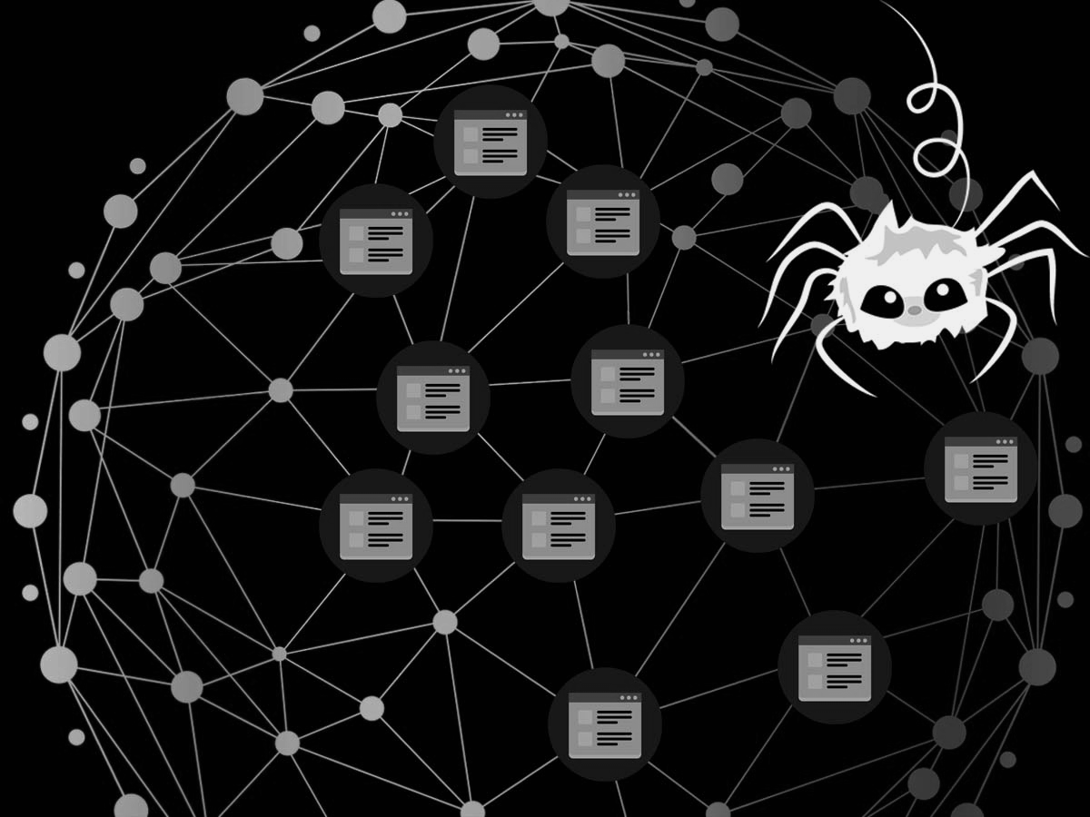
Tasks and Attributes
Tasks:
Crawls 24 pages which are all the pages for the top 240 restaurants in Hartford
Initial Seed Set: Set of URLS from Yelp focused on Hartford area with Birds-eye view.
Attributes:
File Storing
User Agent “Safari”
Error Handling
Data Backups
Main Components:
.connect
.getElementsByTag
.getElementsByClass
.getDouble
.getInt
.select
Object Store

Slide 9
How does YelpScrape work?:

Slide 10
Description of Components
Method: | Function: | How we used it:
.getElementsByClass | Getting elements by their tag | Gathering the list (li) tags from HTML files
.getElementsByTag | Getting the elements by their class | Get the class that holds all the li tags for the restaurants
.select | Select the elements from the file | Selects the titles, reviews, and ratings contained under the li tag
.getDouble | Get a double value | Gets the double value from what is scraped for the ratings
.getInt | Get an integer value | Gets the integer value from what is scraped for the reviews
Object Store | Stores an object, such as a String, Integer or Double | Holds reviews, name, and ratings of the restaurant
.connect | Connects to the URL | Connect to Yelp’s URL that is of the Hartford area with Bird’s Eye View

Slide 11

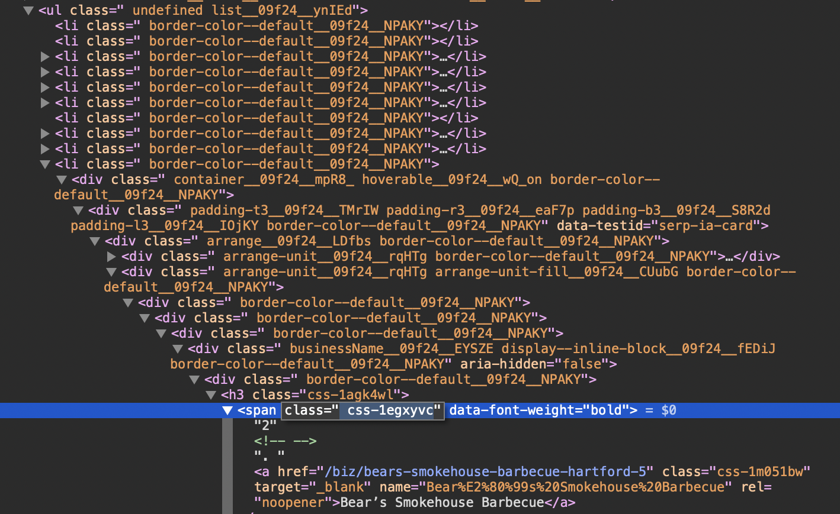
Step One: Locating the Information
All the restaurants were in an ul class.
Each restaurant had its own li class.
Within them, they had 3 span classes that held title, reviews, and ratings.

Slide 12
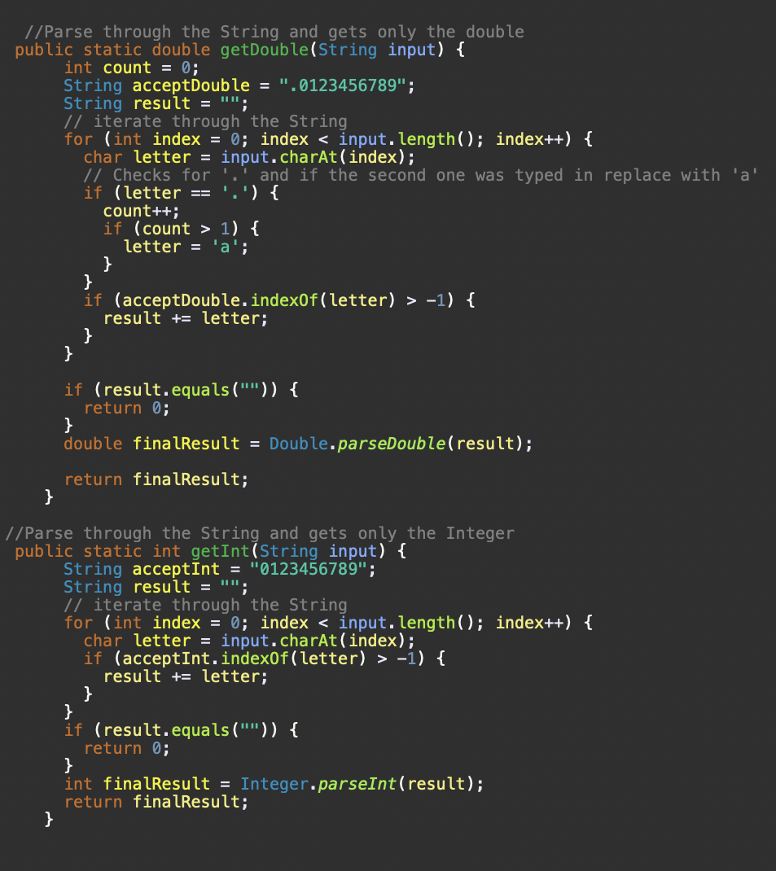
Step 2: Gathering the Data
The data for review needed only the integer and no text attached so the getInt method took only the numbers in String and changed it to Integer.
The data for ratings needed only the double so getDouble method got the numbers and converted it to a double

Slide 13
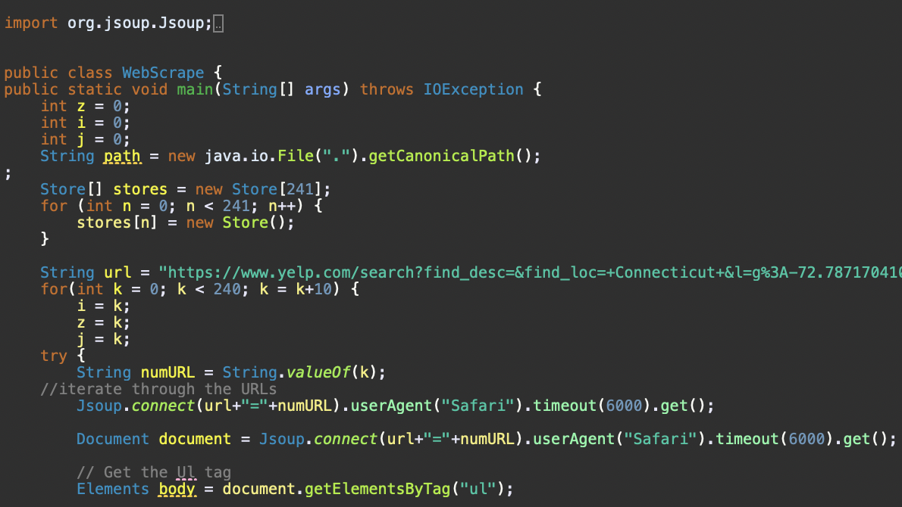
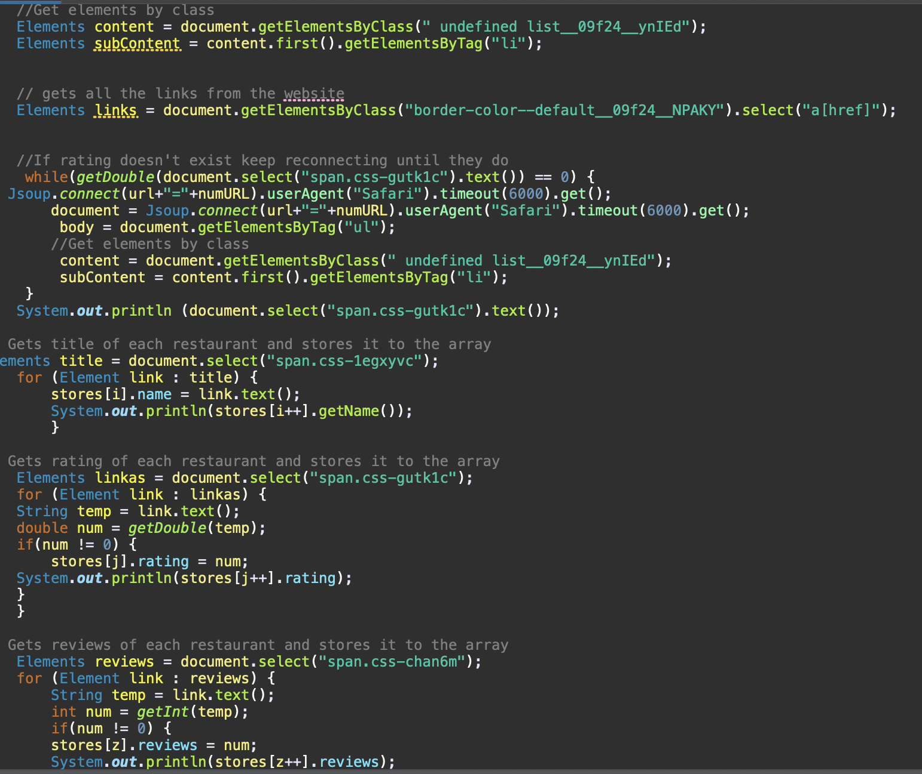
More Gathering…
YelpScrape connects to the URL
Gets the ul class that holds all the restaurants
Gets all the li class elements.
Gets the span classes that hold reviews, ratings, and names.

Slide 14
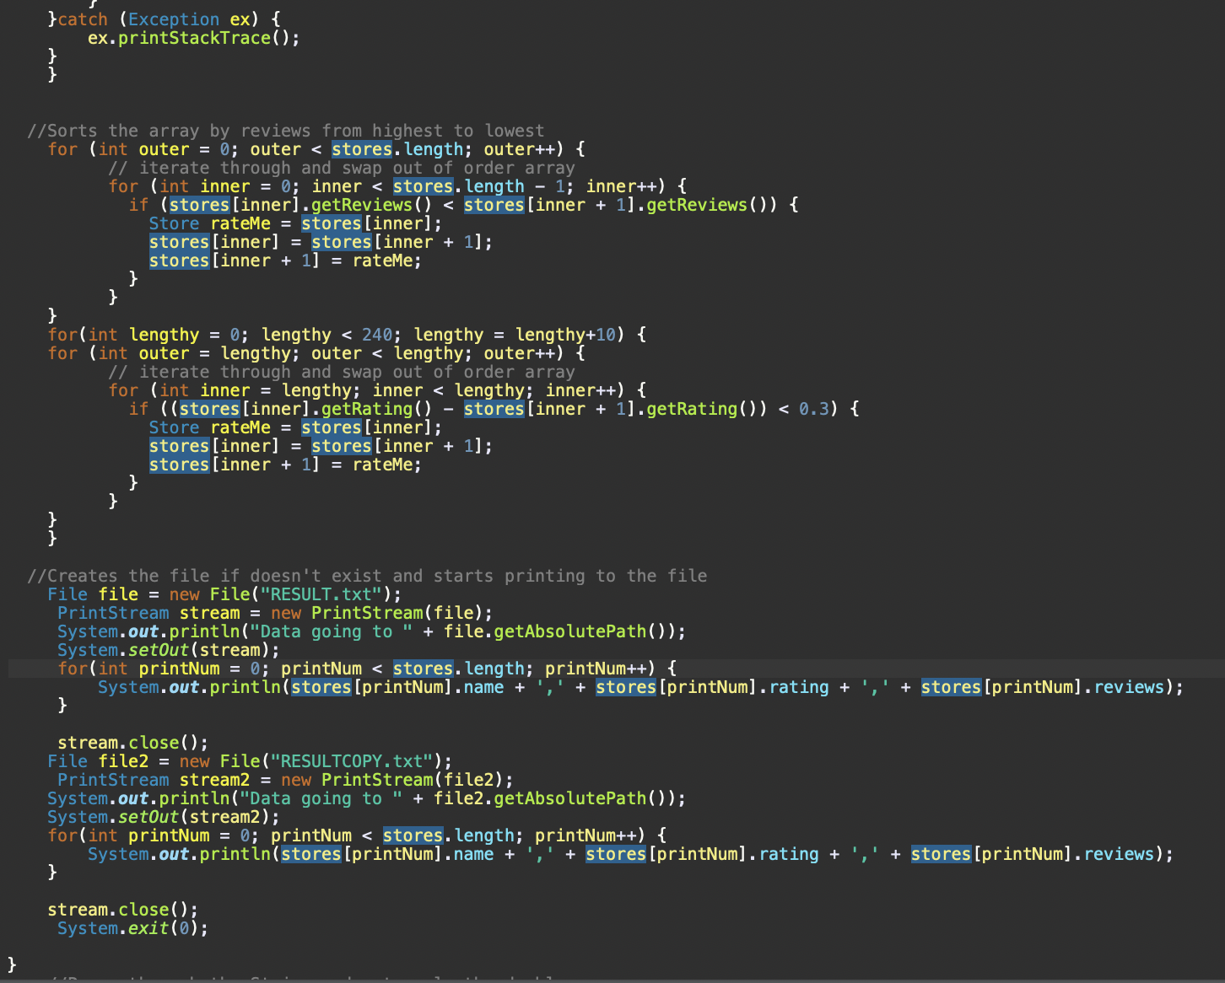
Step 3: exception handling and file storage
File scrapy sorts all the restaurants by reviews and rating.
Then stores results into RESULTS.txt and a backup in RESULTSCOPY.txt

Slide 15
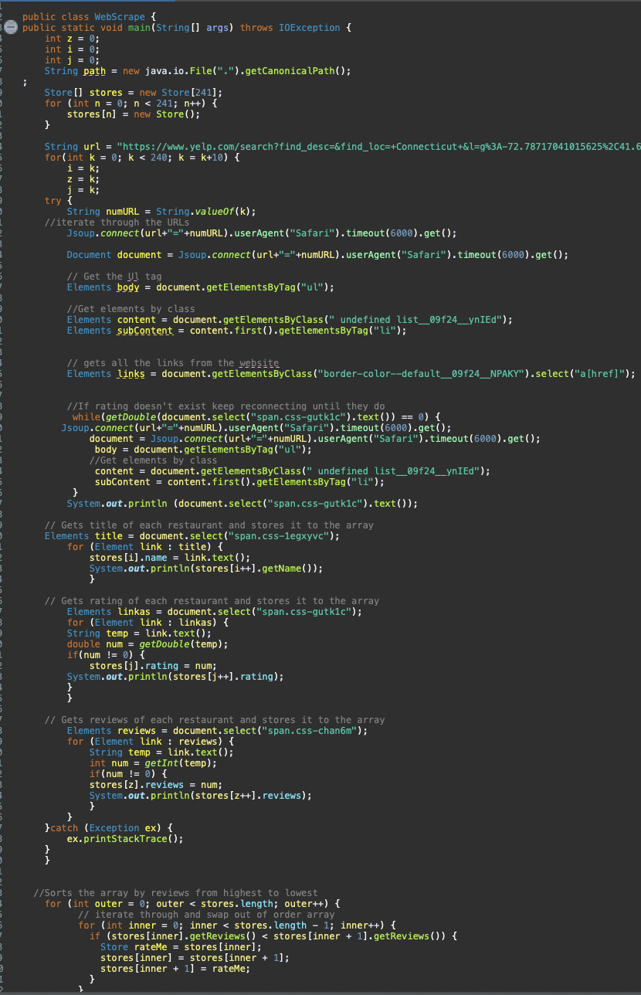
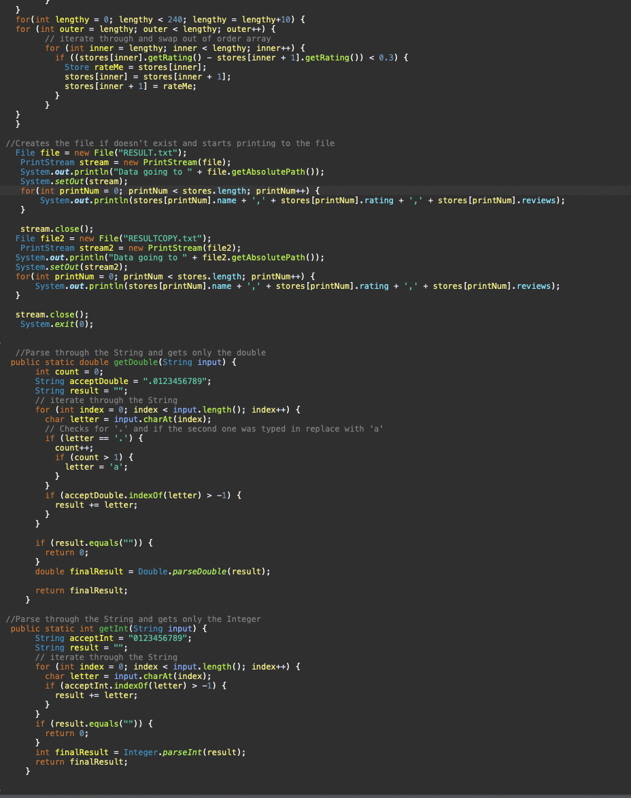
The Final Code

Slide 16
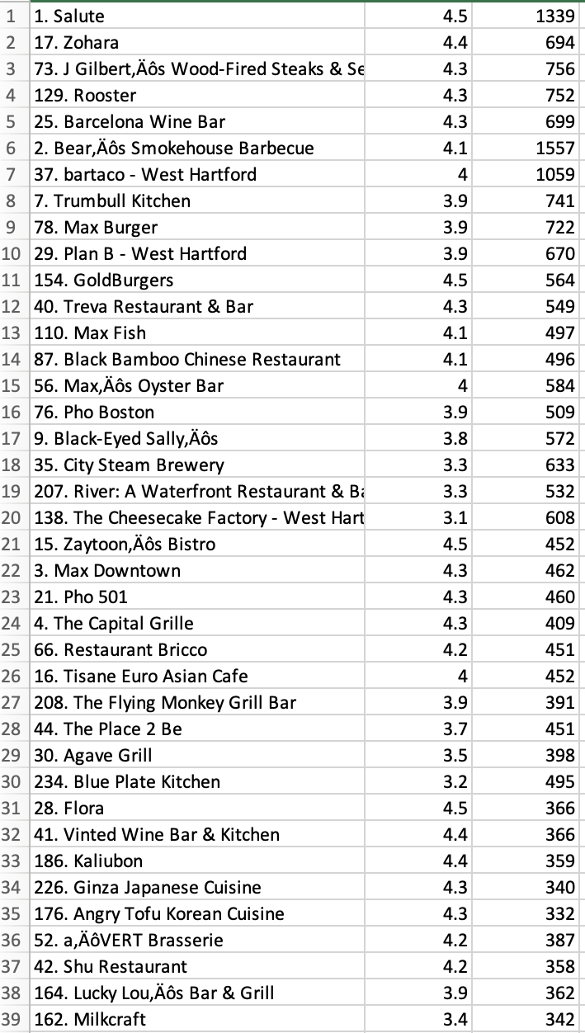
Step 4: Results Results RESULTS!
The results Yelps ranking of restaurants vs YelpScrape
Rooster is rated 129 out of 240 on Yelp but in our YelpScrape it is ranked 4th.
GoldBurgers is ranked 154 on Yelp but it is 11th on YelpScrape.
Yelp also has far lower bot reviewers compared to its competition like Google giving us a far more accurate list.

Slide 17
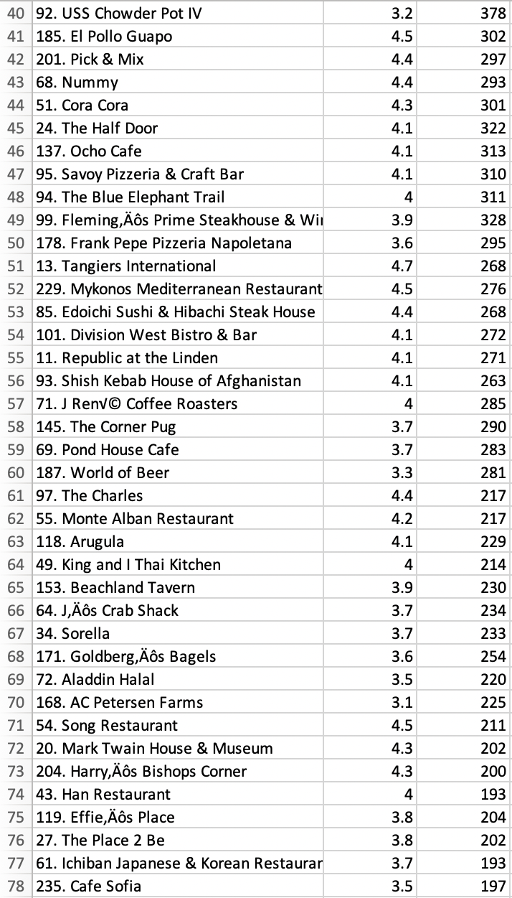
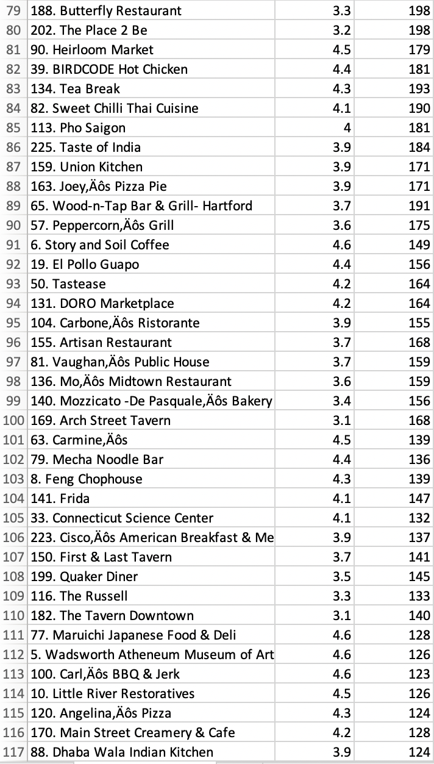
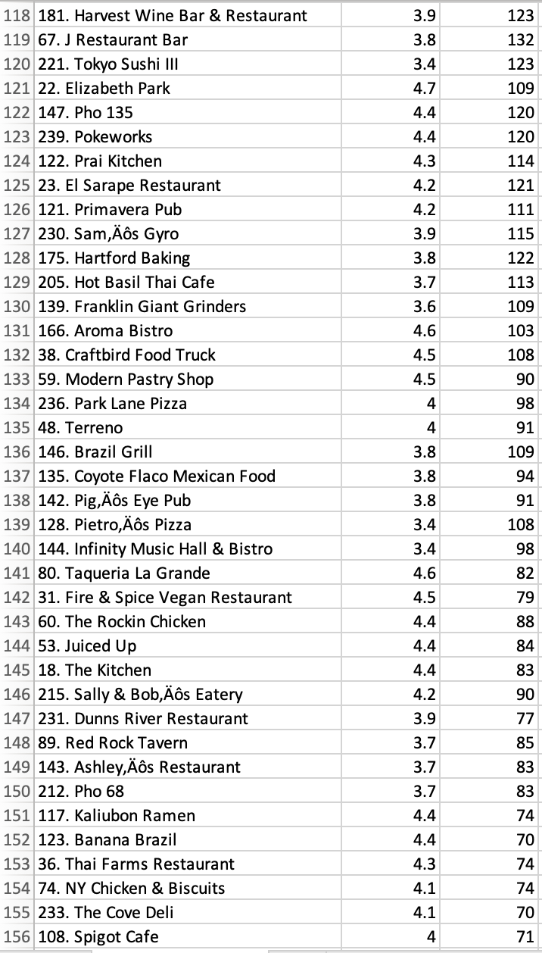
More Results

Slide 18
Analysis:

Slide 19
Question 1:
How to identify crawler traps and avoid them?
The crawler is able to identify the Yelps trap of not having the digit form of ratings exist except every 3-4 times you reconnect. Our crawler checks if the span class for the rating exist if it doesn’t our crawler keeps reconnecting till it does.
Another trap was Yelp asks if are you a robot and needs CAPTCHA if our crawler attempts to request to connect to a new URL too often without a delay. So we added a timeout to slow the requests to avoid “are you a robot.”

Slide 20
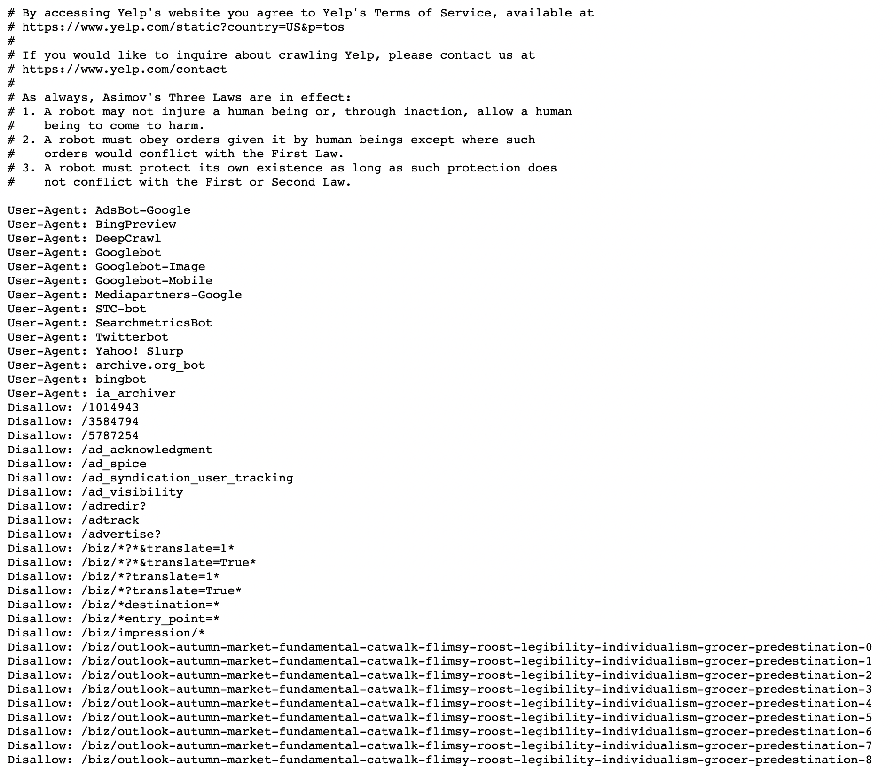
Question 2:
How to design a polite, benign web crawler?
“Elpy reads the rules” : YelpScrape iterates through URLs but always double checks the Disallowed URLs that are listed in Yelp’s robots.txt file.
“Elpy doesn’t like to be bothersome”: YelpScrape includes a delay function of 6000ms between connecting to Yelp so it doesn’t make Yelp’s server busy and we are not sending too many requests
“Elpy has a User Agent”: We provided a User Agent “Safari” since when using a different User Agent name the HTML code changed and made our crawler not able to do what it’s intended to do.

Slide 21

Question 3:
How to implement an efficient web crawler?
Additionally, it tries to reconnect only when it’s necessary and only accesses 24 different URLs to get all 240 restaurants.
It will also ignore the rest of the website and only extracts the reviews, names, and ratings of the restaurants.
YelpScrape only takes the integer data for the reviews and double data for the rating ignoring the rest of the String which varies from restaurant to another.

Slide 22
Question 4:
What business and security needs you might consider for your project?
StakeHolders
Requirements
Functional
Non Functional
Security Requirements
Functional
Non Functional

Slide 23
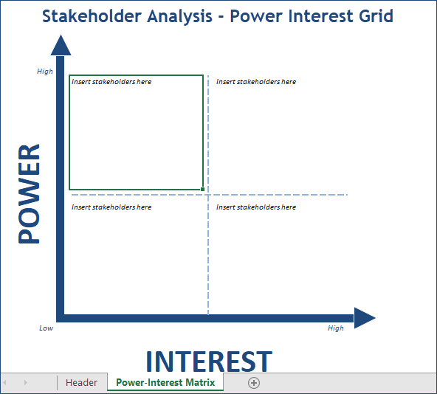
Stakeholders
Restaurant
Dr. Zabihi
Website Managers/Developers
JSoup Developers
Programmers
The Couple
Tourists/food enthusiasts
Food critics

Slide 24
Requirements :
Functional 1: Iterate through URLS found on Yelp
Why should this be part of the system?
As a web crawler, it needs to be able to visit many web pages via a list it is given or one it develops over time.
What are the constraints on this requirement?
If the URL leads the bot to an entirely different site, it needs to review their robots.txt page first.
What are the dependencies for this requirement?
Needs to be able to visit/download the webpages.
Needs to be able to parse a list of URLs.
Needs to be able to review Robots.txt.
Who are the stakeholders for this requirement?
Us (programmers)
Dr. Zabihimayvan
Website Managers/Developers
Jsoup Developers

Slide 25
Requirements:
Functional 2: Gather data on restaurant rating and restaurant reviews
Why should this be part of the system?
This is essentially what our project in particular is all about. We’re looking to analyze ratings from a website in a different manner from the one they provide, but first we need their data.
What are the constraints on this requirement?
We must of course be polite in doing so, not spamming requests too much.
What are the dependencies for this requirement?
This requirement is dependent on the previous one! Must be functional first in its ability to gather data across URLs provided.
Who are the stakeholders for this requirement?
Programmers
Dr. Zabihimayvan
Website Managers/Developers
Jsoup Developers

Slide 26
Requirements:
Functional 3: Restrict Crawler to Restaurants only from Hartford County
Why should this be part of the system?
Keeps crawler focused. Keeps data organized and doesn’t overwhelm the crawler.
What are the constraints on this requirement?
Constrained by location (restricted to only restaurants in Hartford County).
What are the dependencies for this requirement?
Must review restaurant locations, filter out restaurants not located in Hartford County.
Who are the stakeholders for this requirement?
Restaurants
The Couple

Slide 27
Requirements:
Functional 4: Restaurants should be sorted by best to worst based on the rating value and number of reviews
Why should this be part of the system?
We were looking to place the restaurants lower that maybe had a high average but only a few ratings, and therefore need to be able to sort by BOTH number of reviews and rating in order to find the restaurants that are simultaneously popular and high quality.
What are the constraints on this requirement?
Must collect data based on guidelines from robots.txt.
What are the dependencies for this requirement?
Must be able to collect data prior to adding this sorting function.
Who are the stakeholders for this requirement?
Tourists
Restaurants Themselves
Food Critics
The Couple

Slide 28
Requirements:
NonFunctional 1: The Crawler should abide by the rules and guidelines highlighted in Yelp’s robots.txt file
Why should this be part of the system?
Robots.txt sets the guidelines for what our web crawler is allowed to do while visiting.
What are the constraints on this requirement?
Crawler would be constrained by rules found in robots.txt, limit to what URL we are allowed to use.
What are the dependencies for this requirement?
Must review the robots.txt document and compare the URLs it is receiving to the URLs contained in robots.txt.
Who are the stakeholders for this requirement?
Website managers/developers

Slide 29
Requirements:
NonFunctional 2: The Display of the Information should be in an Excel file so it is easy to Understand
Why should this be part of the system?
Stakeholders accessing this info should not have any trouble reading it. They should be able to get the info they’re looking for in a matter of seconds or minutes.
What are the constraints on this requirement?
The data needs to be organized in an intuitive manner, meaning every area to look at has a header, possibly a short description to manage how the user follows it.
Needs to be able to access Excel.
What are the dependencies for this requirement?
The crawler needs to sort the data prior to this step.
Who are the stakeholders for this requirement?
Tourists
Restaurants
Critics
The Couple

Slide 30
Requirements:
NonFunctional 3: The Crawler Will Not Send Too Many Requests to the Yelp Servers
Why should this be part of the system?
Part of being benign includes not sending an exorbitant amount of requests to Yelp (or any website for that matter).
What are the constraints on this requirement?
The number of requests sent by our crawler should be based on the rules set by Robots.txt.
What are the dependencies for this requirement?
Needs to check how many refreshes are allowed, determine how much data is needed + how long it takes to acquire that amount.
Who are the stakeholders for this requirement?
Website developers/managers

Slide 31
Requirements:
NonFunctional 4: The Crawler’s programming should be flexible and can be used on any other restaurant rating site
Why should this be part of the system?
Versatility; Our crawler should be able to be used on different websites and yield similar results.
What are the constraints on this requirement?
Robots.txt guidelines – some URLs may not allow for crawler to access.
What are the dependencies for this requirement?
The crawler needs to be able to review Robots.txt and follow their rules prior to visiting a site in the first place.
Who are the stakeholders for this requirement?
Website Developers/Managers

Slide 32
Security Requirements:
Functional 1: Close Result Files After Use
Why should this be part of the system?
It prevents malicious users from accessing our results and changing them or deleting them.
What are the constraints on this requirement?
Must have all required data prior to closing the file, immediately after.
What are the dependencies for this requirement?
Code, Java itself, reliability of the code, accuracy of the programmer knowing what they are doing.
Who are the stakeholders for this requirement?
Programmers
Tourists
The Couple
What are the exceptions to the normal case for this requirement?
In the case that Elpy is intercepted by a malicious user, they can be fed a string of infinite length. Such a thing would result in Elpy trying to infinitely write to our results file. This will in turn cause a memory error.
What sensitive information is included in this requirement?
Data that was acquired from each URL.
What are the consequences if the conditions of this requirement are violated? (error handling; how to fail safely without compromise)
It puts the results at risk of being contaminated or corrupted.
What happens if this requirement is intentionally violated? (examining the potential for attacks; is the data mission-critical?)
If it is intentionally violated, it shows distrust in our services and violates confidentiality in the CIA triad because the data would no longer be kept private.

Slide 33
Security Requirements:
Functional 2: Backup any and all data obtained
Why should this be part of the system?
In case of a system failure or corruption of data, a backup can be helpful to lose less, or no, data.
What are the constraints on this requirement?
Backup needs to be encrypted.
What are the dependencies for this requirement?
Need to have double the storage space set aside to account for double the data being saved.
Who are the stakeholders for this requirement?
Dr. Zabihimayvan
Programmers
Tourists
Food Critics
Restaurants
The Couple
What are the exceptions to the normal case for this requirement?
When there isn’t enough extra space to create a copy, this prevents a backup attempt from being successful. To work around this, Elpy should either delete an older backup, or overwrite an old backup entirely.
What sensitive information is included in this requirement?
None, as all data we gather is publicly available.
What are the consequences if the conditions of this requirement are violated? (error handling; how to fail safely without compromise)
If the conditions of this requirement are violated, the system could cease to function altogether until data is gathered again, sorted again, etc.
What happens if this requirement is intentionally violated? (examining the potential for attacks; is the data mission-critical?)
If this requirement is intentionally violated, the system as a whole will come to a halt if data is corrupted.

Slide 34
Security Requirements:
NonFunctional 1: Should not allow vulnerabilities into site
Why should this be part of the system?
Could compromise the website, allowing unauthorized entities access to website codes/ programs.
What are the constraints on this requirement?
Must close connections to site once data is collected.
What are the dependencies for this requirement?
This depends on some earlier requirements, such as our ability not to overload a site with requests, and abiding by Robots.txt.
Who are the stakeholders for this requirement?
Programmers
Dr. Zabihimayvan
Website managers/developers
What are the exceptions to the normal case for this requirement?
In the case that a connection is not severed from the site, we possibly open a vulnerability into their site, or Elpy. In these cases, Elpy looks at its timeout timer, and will close the connection according to that.
What sensitive information is included in this requirement?
Codes, scripts
What are the consequences if the conditions of this requirement are violated? (error handling; how to fail safely without compromise)
Compromised website, could lead to potential attacks on to users (e.g. DDos Attacks).
What happens if this requirement is intentionally violated? (examining the potential for attacks; is the data mission-critical?)
Would mean the crawler is harmful and not benign; means that it could be blocked by other major website in the future.

Slide 35
Security Requirements:
Nonfunctional 2: Error Handling
Why should this be part of the system?
Allows the program to detect errors inside the code to prevent instances of buffer overflow.
What are the constraints on this requirement?
Must be able to recognize an error is present and terminate the system if all else fails.
What are the dependencies for this requirement?
Depends on our ability to brainstorm possible errors ahead of time.
Who are the stakeholders for this requirement?
Programmers
Dr. Zabihimayvan
Website Managers/Devs (errors on our end could open up vulnerabilities on their end)
What are the exceptions to the normal case for this requirement?
If an unforeseen error pops up that Elpy can’t handle, this could cause a vulnerability in our system. At times like this, Elpy will instead shut down, as Java programs handle unforeseen errors in this manner. However, this also opens up a vulnerability.
What sensitive information is included in this requirement?
The Programmers’ Code
What are the consequences if the conditions of this requirement are violated? (error handling; how to fail safely without compromise)
If errors are not handled efficiently, we could open up vulnerabilities on our end, or even on the target sites’ end(s).
What happens if this requirement is intentionally violated? (examining the potential for attacks; is the data mission-critical?)
If this requirement is intentionally violated, we break the trust of our users, the target site, and JSoup developers. Negligence in this department could also result in the failure of our system as a whole.

Slide 36
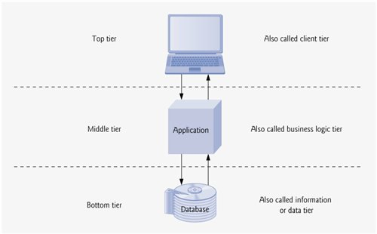
Question 5:
What type of architecture did you use for your software?
The architecture we used is 3 tier since Application and Client run on the same computer, then it connects to another application (Yelp) on another server. Finally that Application requests the data from its Database which is on another server.

Slide 37
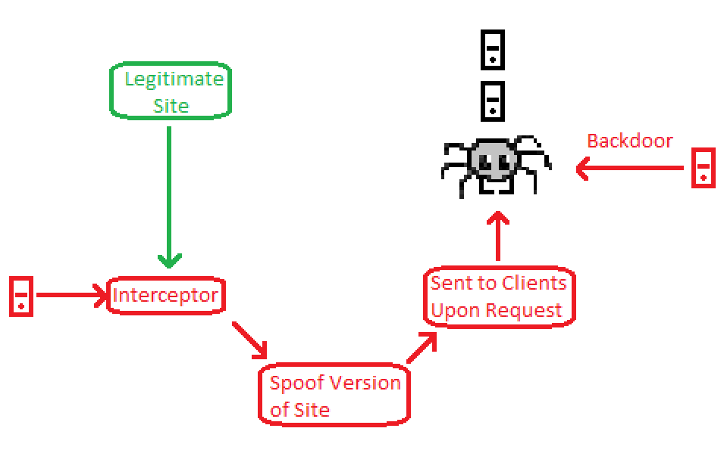
Question 5:
Based on the architecture, what threat model can you suggest for your software?
What threats might a spider such as Elpy face?
Eavesdropping is the main threat Elpy could face as he makes his way through Yelp’s reviews. This can be mitigated by running Elpy through a VPN.
Another vulnerability for Elpy are backdoor attacks. Although we would like for Elpy not to have to look over his shoulder, we felt this was necessary.

Slide 38


To Conclude…
In the end, the couple was able to receive a list of the best restaurants located around Hartford, thanks to “Elpy” and the programmer team! Now, the couple has over 240 restaurants to choose from and they are more than eager to have wonderful date nights for years to come!
The programmers were able to construct “Elpy” to help the couple and through this they learned important lessons of being kind to the websites one visits.
As celebration, the couple invited the programmers to a meal at Mecha Noodle Bar that had a 4.4 star rating. Who knows, maybe they will all be adding reviews of their own after they eat!
N fhfghfhfhfhfhfhtgggdddddd

Slide 39
Questions?
Questions?
Questions?Questions?
Questions?
Questions?
Questions?
Questions?
Questions?
Questions?
Questions?
Questions?
Questions?
Questions?
Questions?
Questions?
Questions?
Questions?
Questions?
Questions?
Questions?
Questions?
Questions?
Questions?
Questions?
Questions?
Questions?
Questions?
Questions?
Questions?
Questions?
Questions?
Questions?
Questions?
Questions?
Questions?
Questions?
Questions?
Questions?
Questions?
Questions?
Questions?
Questions?
Questions?
Questions?
Questions?
Questions?
Questions?
Questions?
Questions?
Questions?
Questions?
Questions?
Questions?
Questions?
Questions?
Questions?
Questions?
Questions?
Questions?

